Slide 1

Haptic Horizon
Sean Balbale, Johanna Woldeher, Crystal Kim, Donovan Chang
18/04/2024

Slide 2
Table of contents
01
02
03
04
05
Introduction
The Design
How it Works
Improvements
Summary and Conclusion
References
Q&A

Slide 3
01
Introduction

Slide 4
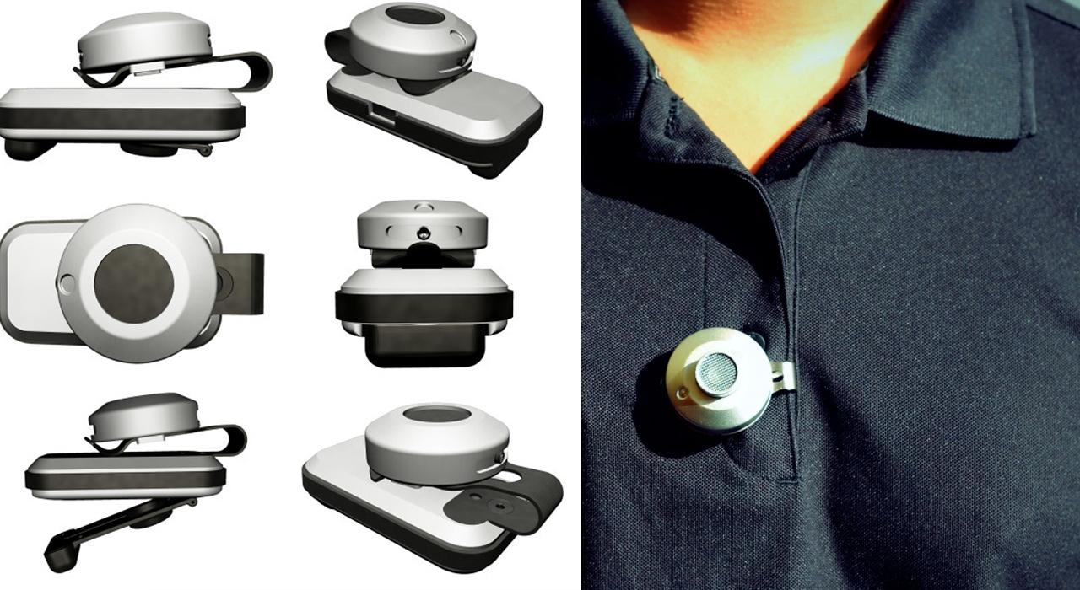
Introduction
Aims
Current Options
Similar Examples
Helps blind people move
Free Hands
Safety
Electronic mobility aids
Walking canes
Service animals
BuzzClip
(www.youtube.com, n.d.)
(Springwise, 2017)
Notes:
Our project introduces a wearable haptic alarm system tailored for the visually impaired, aiming to provide intuitive alerts for obstacle detection and navigation assistance.
Current options, such as electronic mobility aids and white canes, have drawbacks in terms of portability and user-friendliness.
Examples of existing devices include the BuzzClip, which employs ultrasound for obstacle detection but lacks comfort

Slide 5
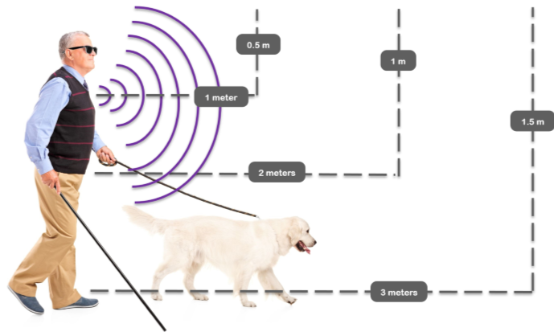
Background and Core Idea
Background
Core Idea
Physical Resources
Current solutions are limited
Need for innovation
Portability
User-friendliness
Hands-free
Departure from reliance on auditory cues
(hmi-basen.dk, n.d.)
Notes:
Background: Discuss limitations of current solutions and the need for innovation.
User skill → need training, time, and practice ; difficult to navigate in complex environments
Core Idea: Introduce our creative design prioritizing portability, user-friendliness, and hands-free operation.
Mention the departure from reliance on auditory cues in favor of haptic vibrations for real-time feedback.

Slide 6
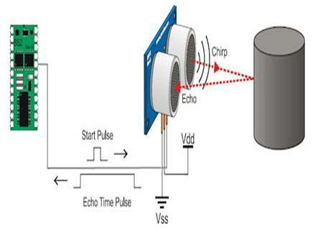
Proposal
Intuitive alerts for obstacle detection and navigation assistance
Utilizing haptic vibrations delivered through a lanyard device for hands-free operation
Methodology: ultrasonic sensors, Arduino, motors, and 3D printed mounts from the SparkFun kit
(Satish, 2017)
Notes:
Our wearable haptic alarm system aims to provide intuitive alerts for obstacle detection and navigation assistance to the visually impaired.
Utilizing haptic vibrations delivered through a lanyard-hung device for hands-free operation.
Methodology: Utilizing ultrasonic sensors, Arduino, motors, and 3D printed mounts from the SparkFun kit for construction.

Slide 7
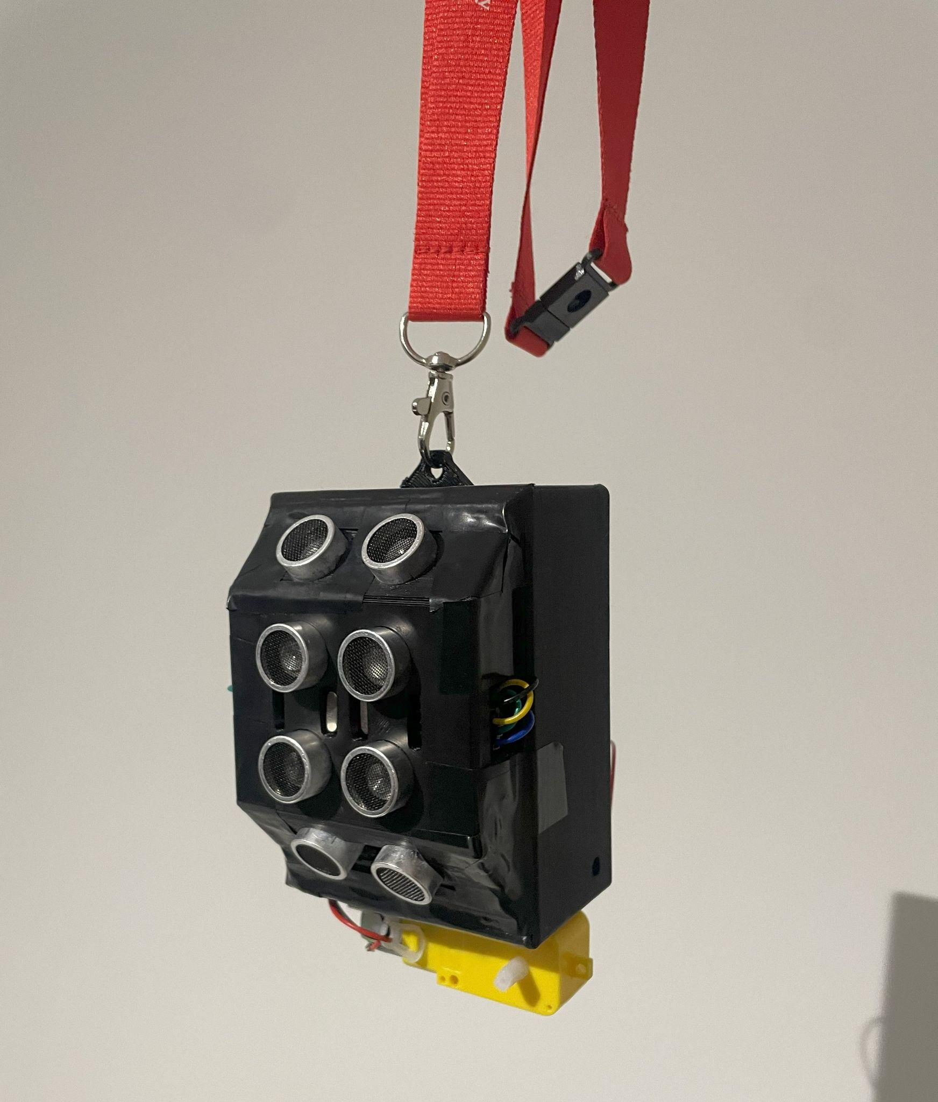
02
The Design
(Chang, 2024)

Slide 8
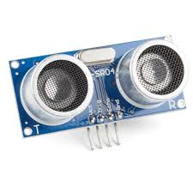
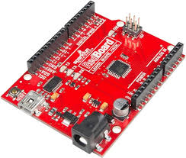
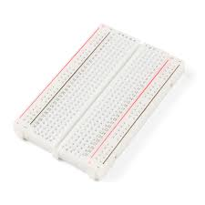
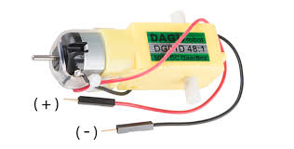
Technology Overview-Components
Ultrasonic sensors
Arduino UNO
(learn.sparkfun.com, n.d.)
(learn.sparkfun.com, n.d.)
Breadboard (sparkfun)
Motor (sparkfun)
(learn.sparkfun.com, n.d.)
(learn.sparkfun.com, n.d.)

Slide 9
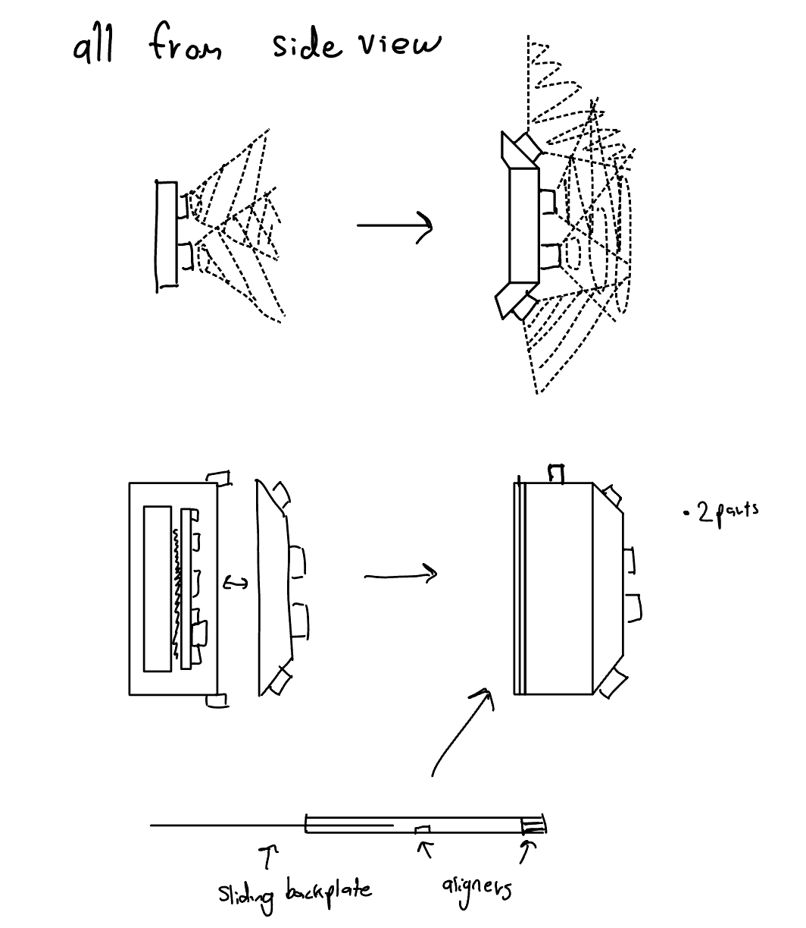
Design Overview
Concept drawing
(Chang, 2024)
Version 1 - Components
Version 1 - Assembly
Version 2 - Redesigned
Version 2 - Redesigned Assembly

Slide 10
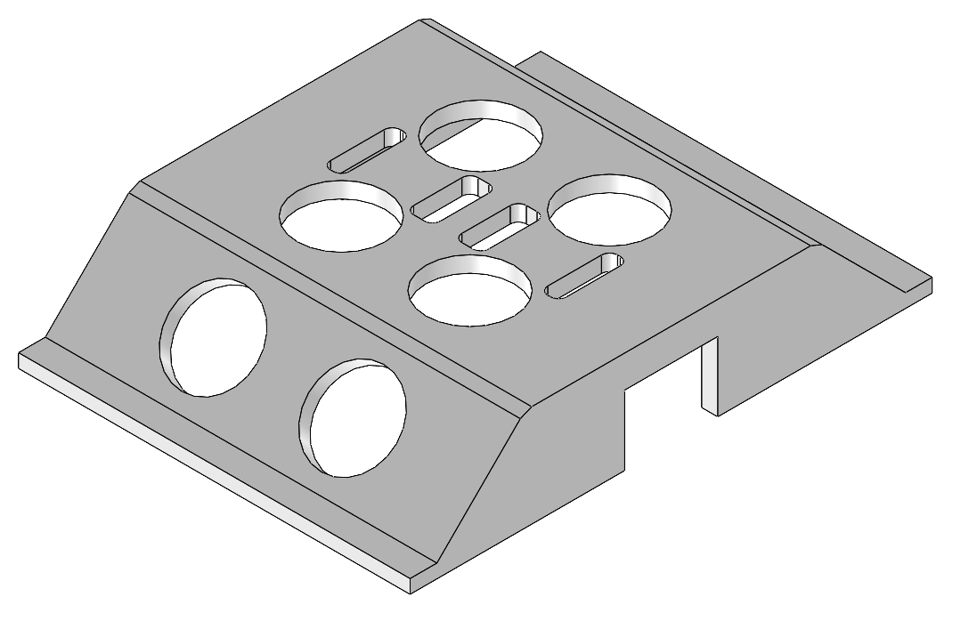
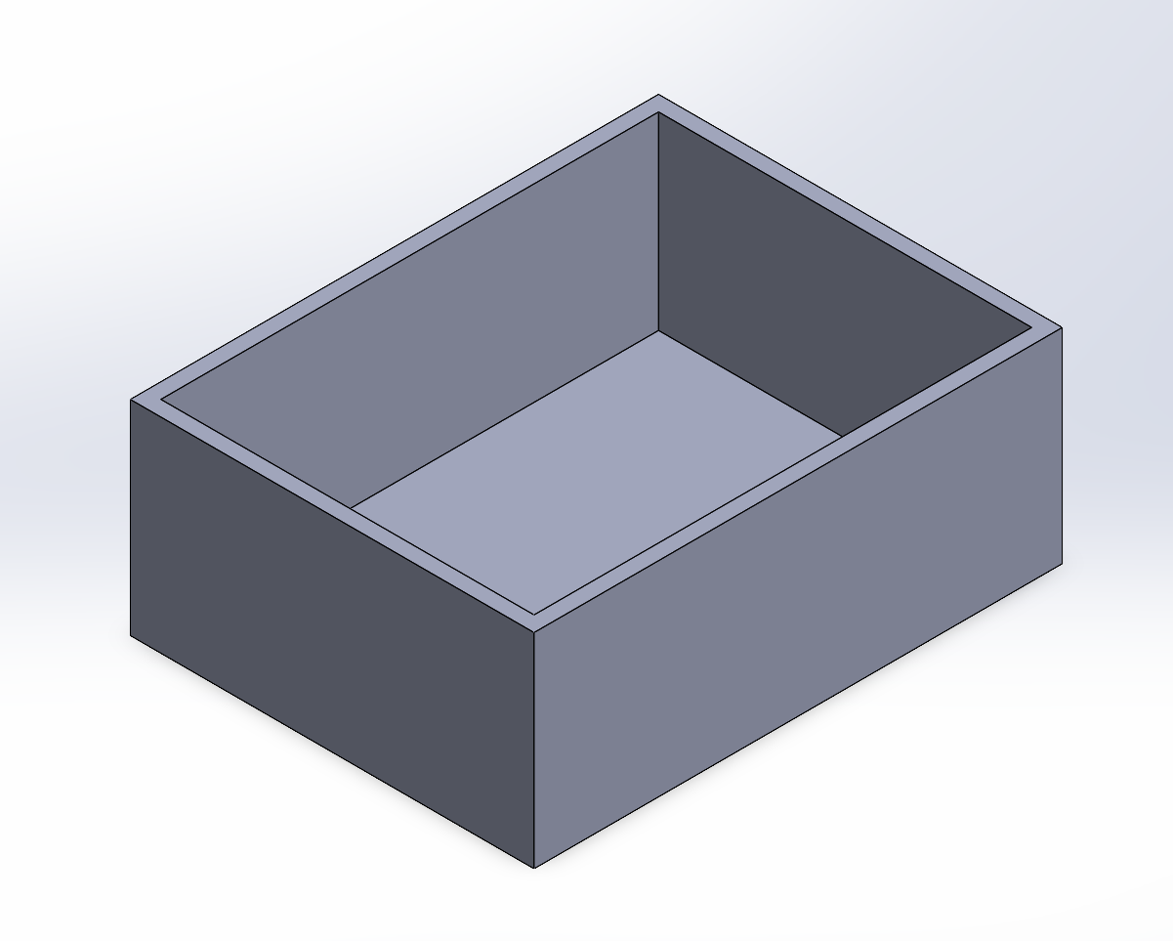
Version 1- Two main Parts
Simple design to see if idea works
It’s a box!!!
(Chang, 2024)
Hole because of wire lengths
Holes for the ultrasonic sensors
(Chang, 2024)

Slide 11
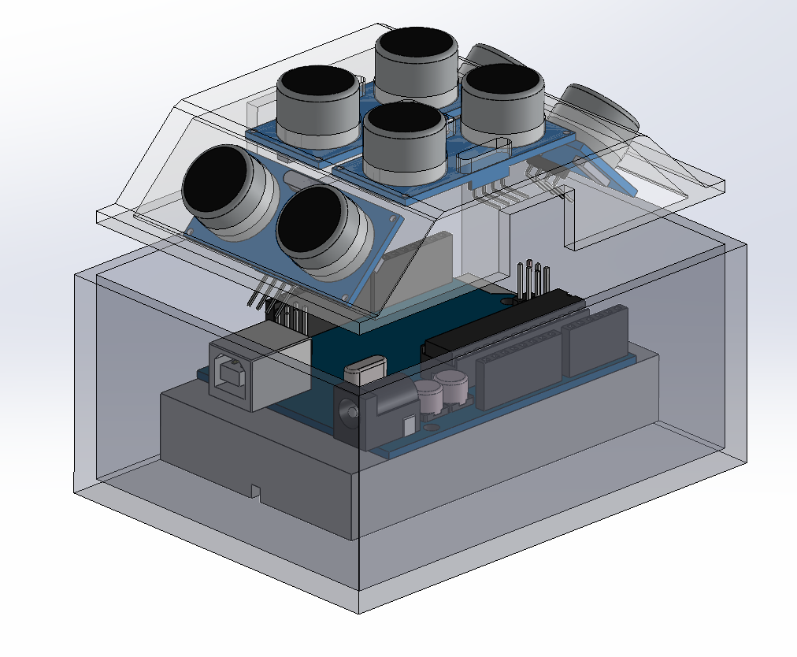
Version 1- Fully Assembled Body
Kinda hard to open and close without messing with wires
Everything without wires can fit inside
Nothing to keep lid on yet
(Chang, 2024)

Slide 12
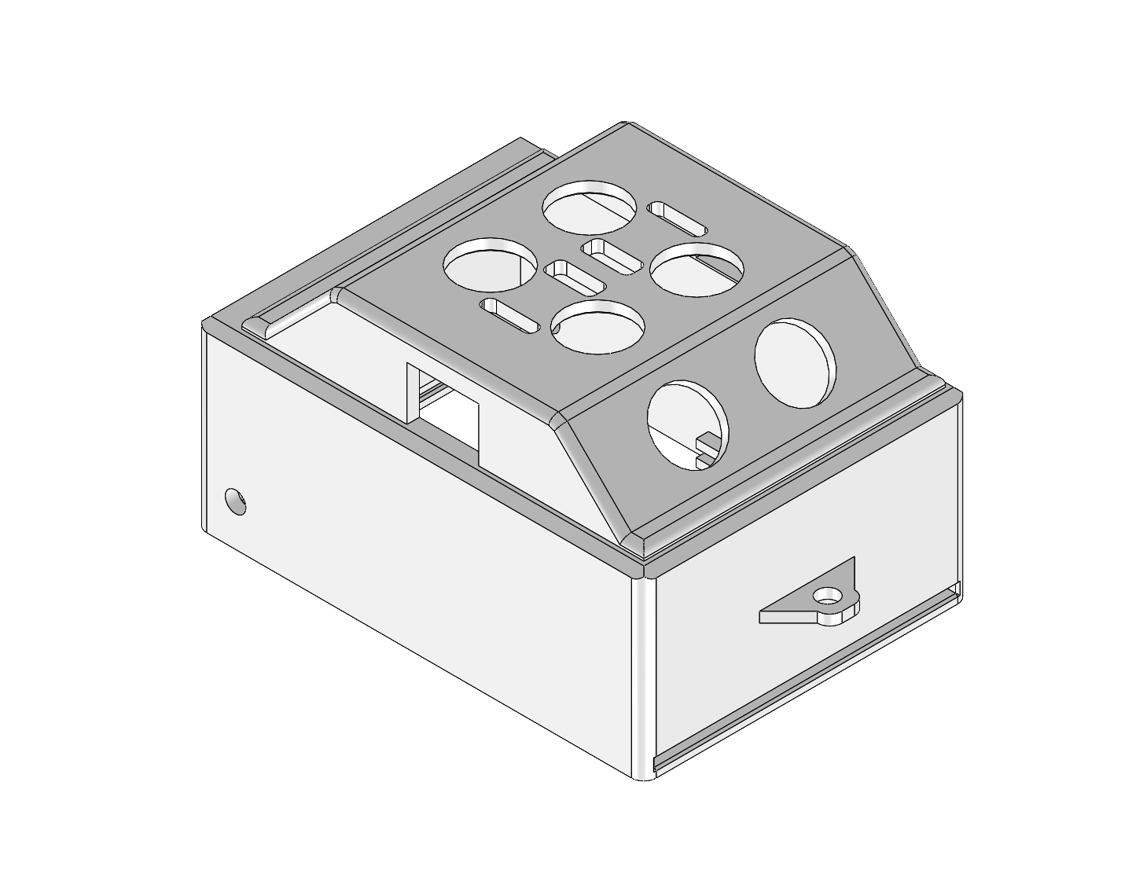
Version 2- Unassembled Body
Combined lid and base
New lanyard mounting hole
New wire hole for motor on outside
New slit base for easy opening and closing
Aligning edge for base
(Chang, 2024)

Slide 13
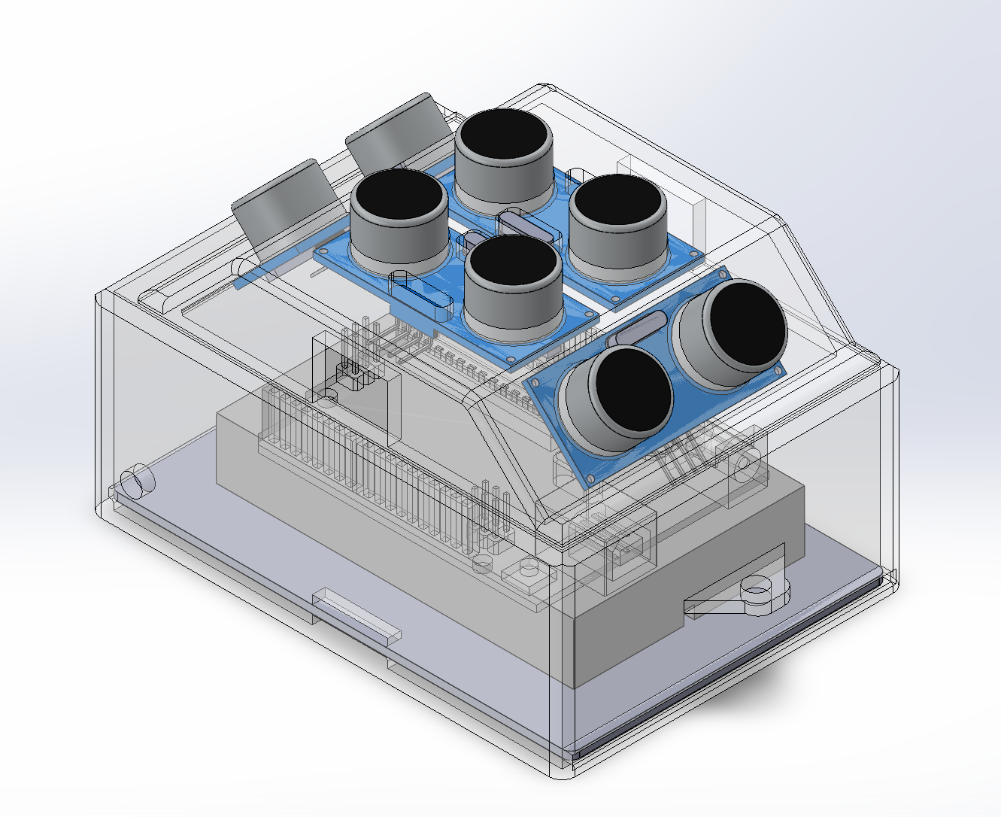
Version 2- Fully Assembled Body
Easier to open and close
(Chang, 2024)

Slide 14
03
How it Works

Slide 15
How it Works
Components
Code Explanation
4 Ultrasonic Sensors
These are used to get the distance from an object.
1 Hobby Gearmotor
This is used to create the vibrations to warn the user.
The purpose of the code
to spin the motor when an object gets within a certain distance of an ultrasonic sensor.
The code is designed to be adjustable so it can be tailored to the individual user

Slide 16
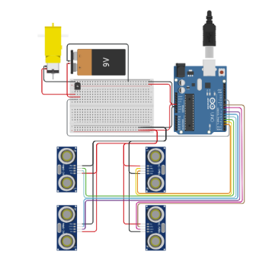
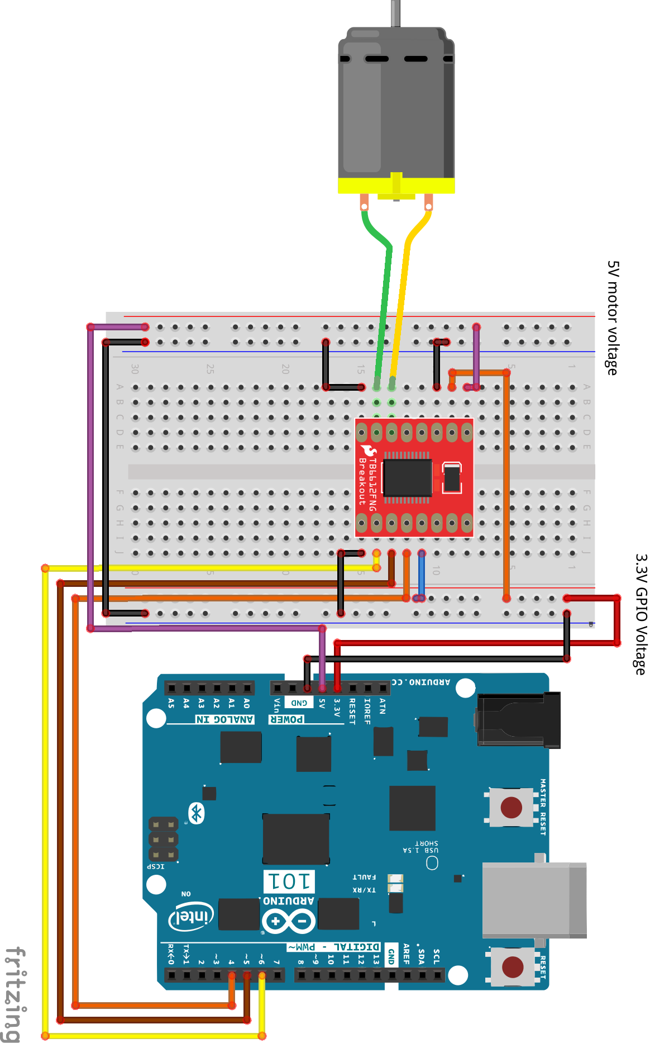
Components Continued
Wiring Diagrams
Our design uses the wiring on the right with the motor controller on the left.
It uses 4 ultrasonic sensors to get the distance to an object.
The arduino then gives a value to the motor driver.
The motor driver causes the motor to spin.
(Balbale, 2024)
(Balbale, 2024)

Slide 17
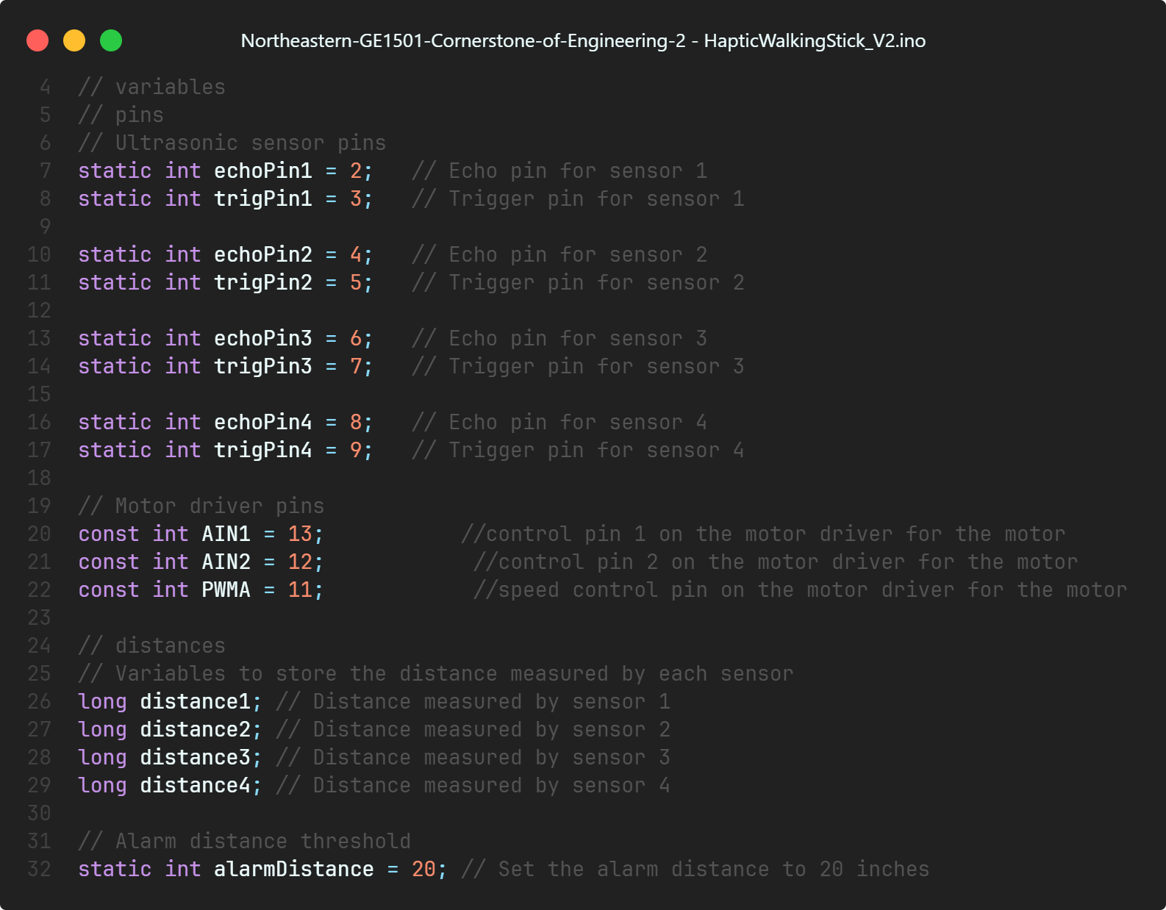
Variables used
Ultrasonic Sensors
Trig
Echo
Motor Driver
Distance recorded
(Balbale, 2024)
Activation Distance

Slide 18
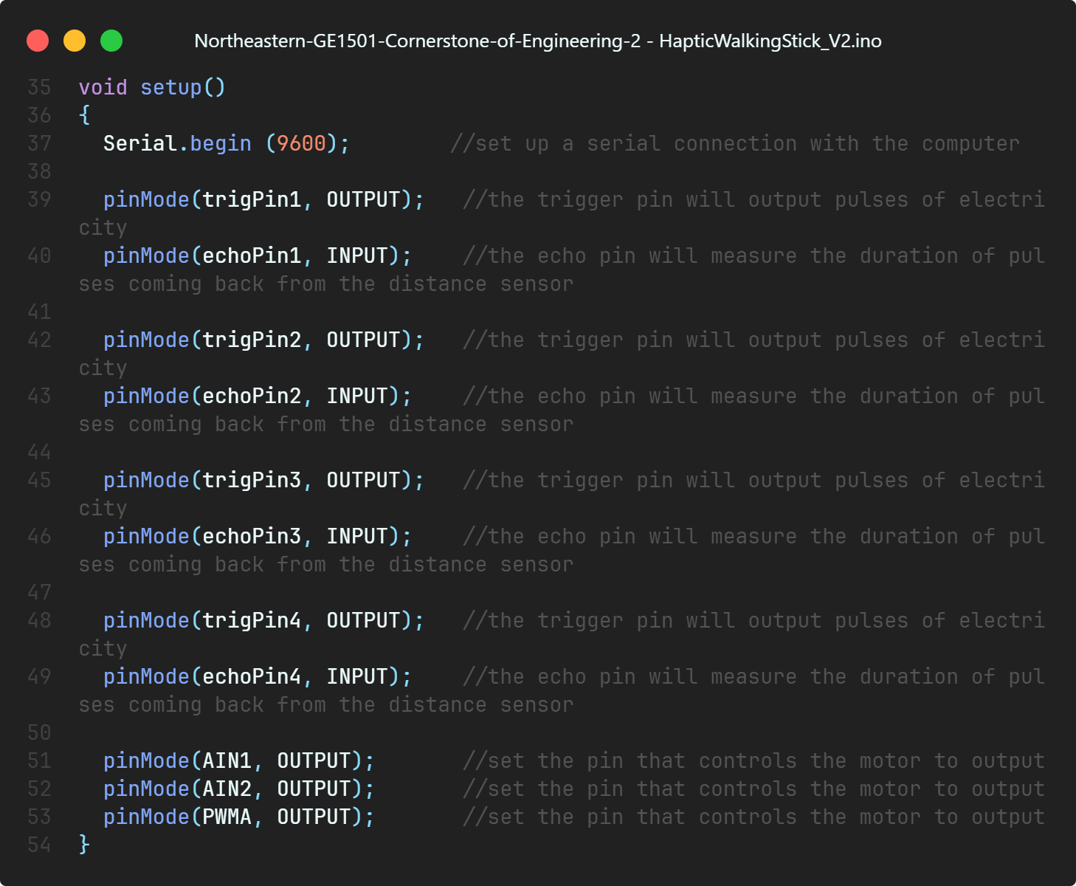
Setup Function
Opens serial port
Input and Output pins for the ultrasonic sensors.
trigPin
echoPin
Motor Driver Output
(Balbale, 2024)

Slide 19
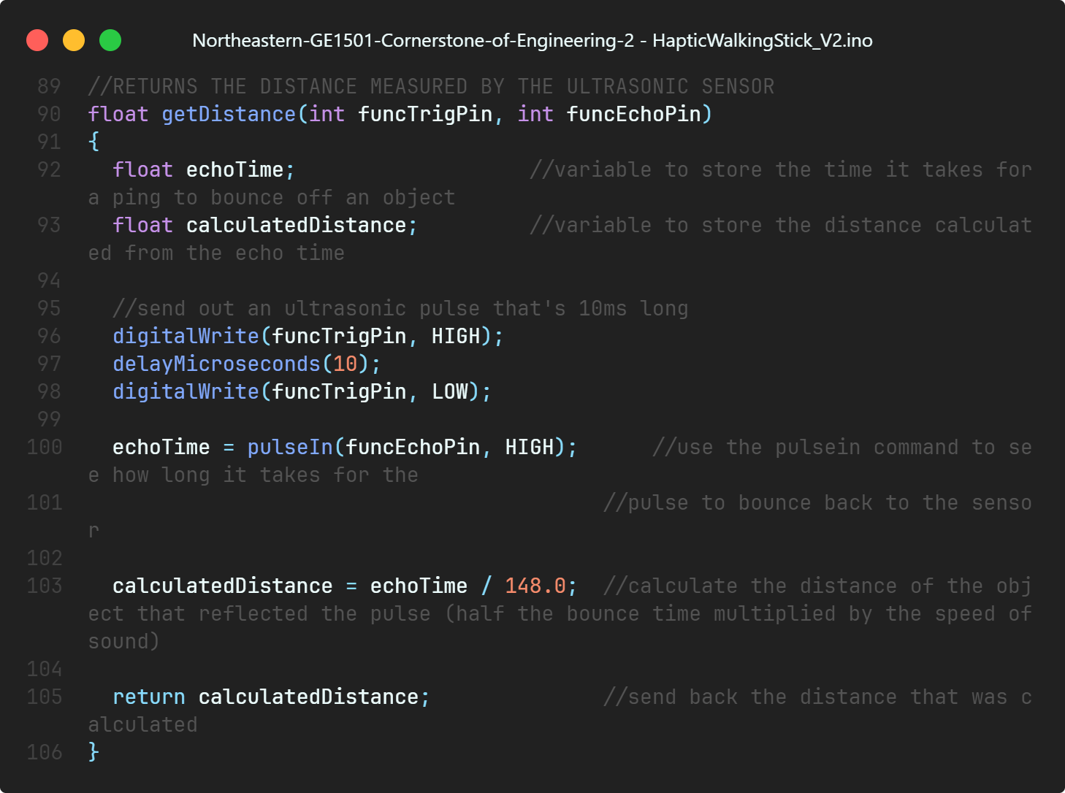
getDistance Function
Finds and records Distance
Defines Variables
Pulses sound and records the time it takes to bounce back.
Calculates the distance an object
Returns Distance
(Balbale, 2024)

Slide 20
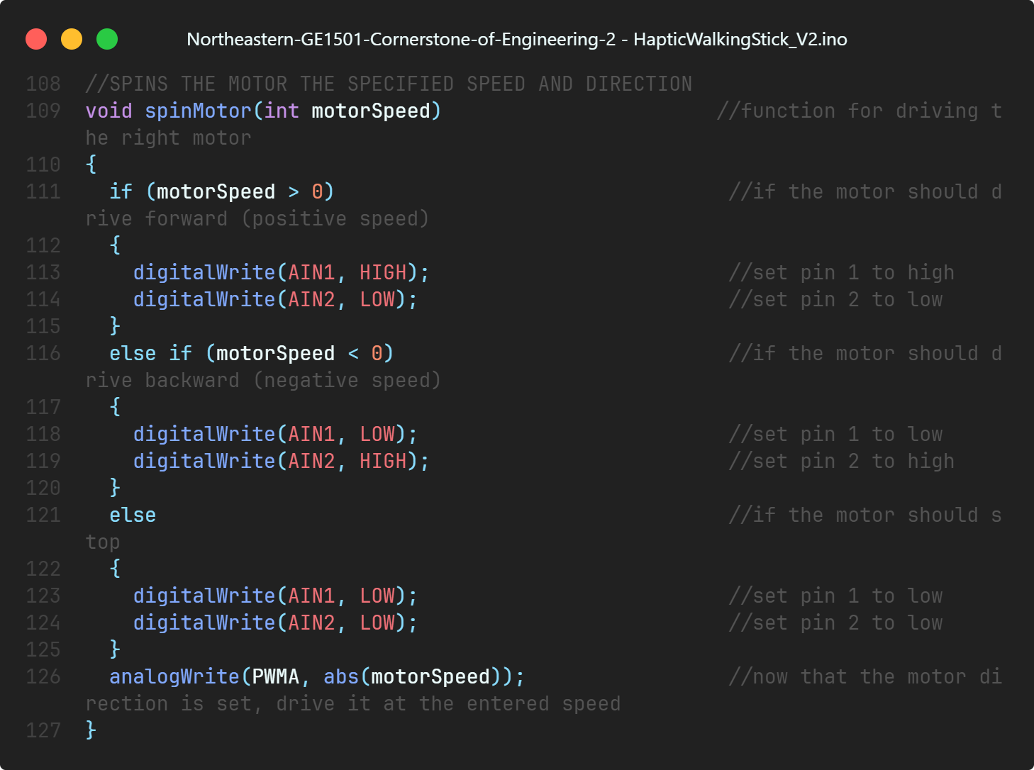
spinMotor Function
This function spins the motor a specified speed.
Positive motor speed
Negative motor speed
Off
(Balbale, 2024)

Slide 21
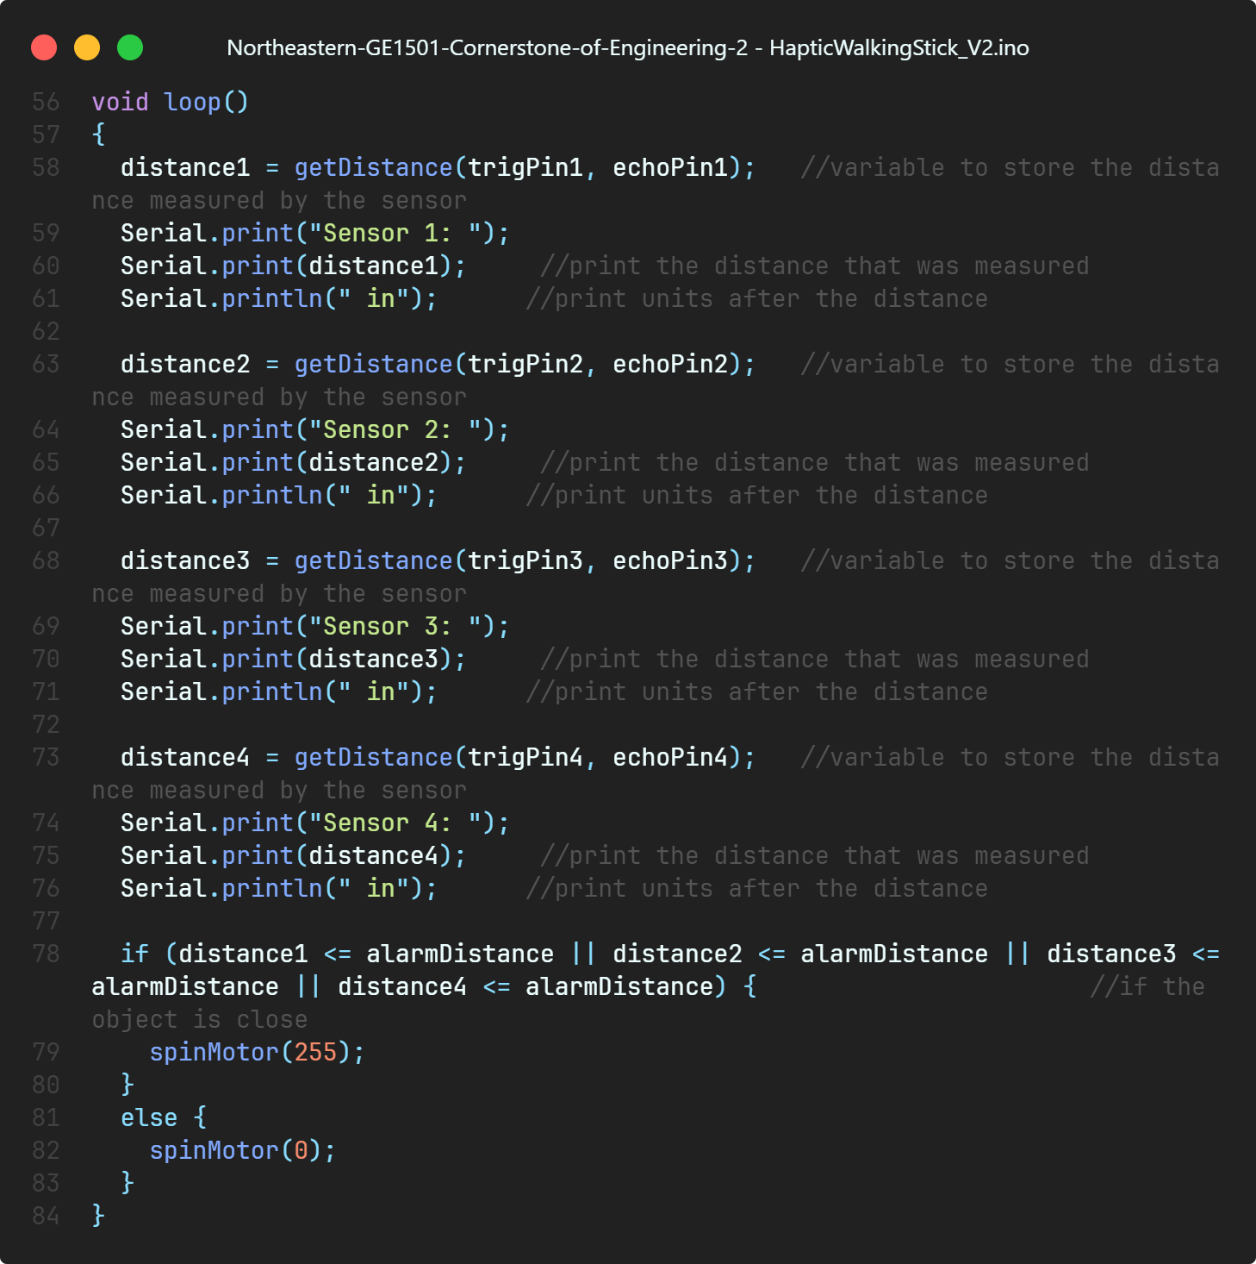
Loop Function
For each sensor
calls getDistance
saves the distance to a variable
prints out the distance to the serial monitor
Spins the motor
(Balbale, 2024)

Slide 22
04
Improvements

Slide 23
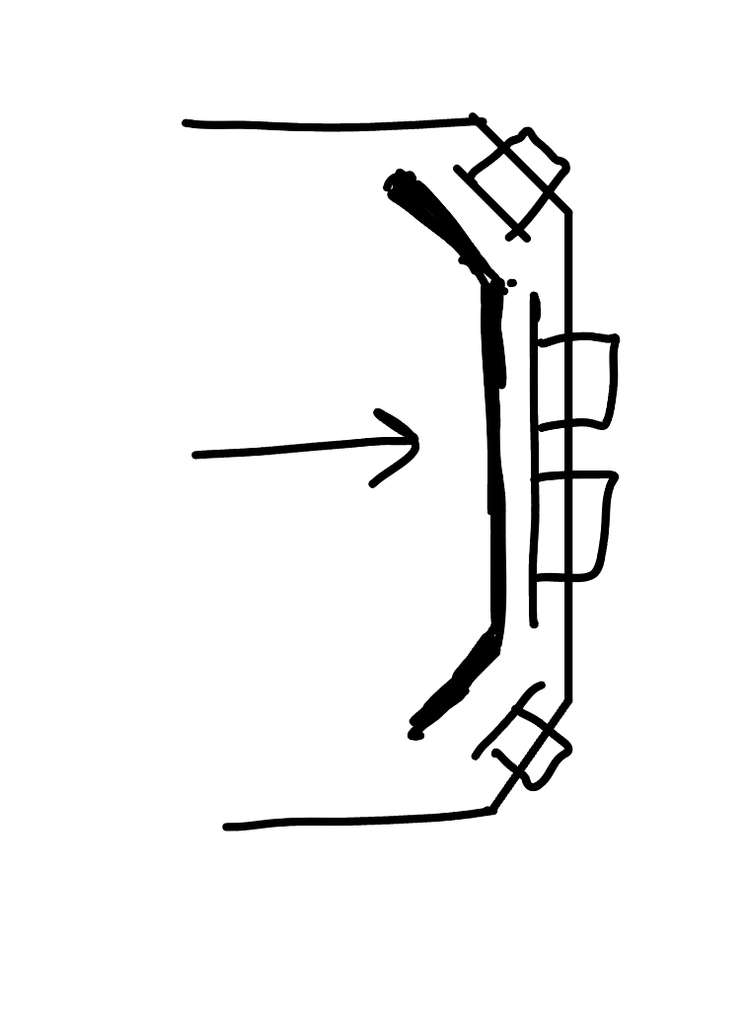
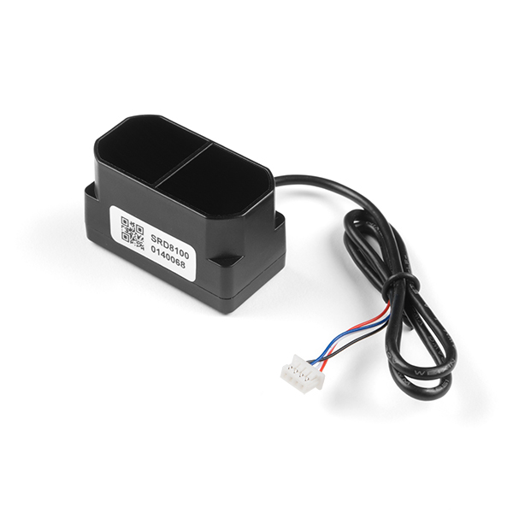
Improvements
Add back plate at the back of ultrasonic sensors
Smaller and more accurate sensors
(learn.sparkfun.com, n.d.)
(Chang, 2024)

Slide 24
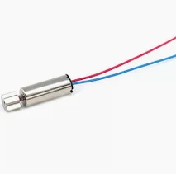
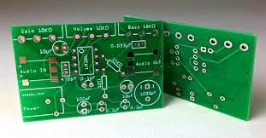
Improvements
Using an actual Haptic motor
Custom wiring/pcb
(Electronics | 23, 2016)
(Precision Mini Drives, 2023)

Slide 25
05
Summary and Conclusion

Slide 26
Summary/Conclusion
Problem
Importance
Our Idea/Design
Improve navigation, safety, and independence for the visually impaired
Hands-free navigation
Portability- easy to wear
User-friendliness
Development of the wearable haptic alarm system
Notes:
Summary: Recap the development of the wearable haptic alarm system and its core features.
Importance: Emphasize the significance of hands-free navigation assistance for the visually impaired.
Mention the improvement in safety and independence for users.

Slide 27
Summary/Conclusion
Future Directions
Methodology
Optimizing low cost options
Preference for Sparkfun Kit parts
3D printing plastic for light weight and customizability
Connections to pedestrian crossings
Smaller design with more accuracy
Notes:
Conclusion: Reiterate the creation of a wearable haptic lanyard for obstacle detection.
Impact: Stress the importance of enabling blind individuals to be hands-free and independent in their daily activities.
Future Directions: Discuss potential enhancements and applications of the technology.

Slide 28
References
www.youtube.com. (n.d.). BuzzClip Review - New Tech for the Blind. [online] Available at: https://www.youtube.com/watch?v=RPyQd-Wnq-8 [Accessed 17 Apr. 2024].
Springwise. (2017). Ultrasound lets users whisper across distance. [online] Available at: https://springwise.com/ultrasound-lets-users-whisper-across-distance/ [Accessed 17 Apr. 2024].
hmi-basen.dk. (n.d.). Buzzclip from LVI Danmark ApS - AssistData. [online] Available at: https://hmi-basen.dk/en/r11x.asp?linkinfo=54725&iaout=1 [Accessed 17 Apr. 2024].
Satish, A. (2017). Detection Principle of Ultrasonic sensor. [online] ResearchGate. Available at: https://www.researchgate.net/figure/Detection-principle-of-Ultrasonic-sensor-The-ultrasonic-sensor-has-been-activated-only_fig2_318960459 [Accessed 1 Apr. 2024].
learn.sparkfun.com. (n.d.). Activity Guide for SparkFun Tinker Kit - learn.sparkfun.com. [online] Available at: https://learn.sparkfun.com/tutorials/activity-guide-for-sparkfun-tinker-kit/circuit-10-motor-basics.
learn.sparkfun.com. (n.d.). SIK Experiment Guide for the Arduino 101/Genuino 101 Board - SparkFun Learn. [online] Available at: https://learn.sparkfun.com/tutorials/sik-experiment-guide-for-the-arduino-101genuino-101-board/experiment-12-using-the-motor-driver [Accessed 17 Apr. 2024].
Precision Mini Drives (2023). 6MM MICRO VIBRATION MOTOR − 15MM TYPE MODEL NFP-P0615-4302. [online] Precision Mini Drives. Available at: https://precisionminidrives.com/product/6mm-vibration-motor-15mm-type-small-vibration-motor-model-nfp-p0615-4302?utm_source=Google%20Shopping&utm_campaign=pmd%20feed&utm_medium=cpc&utm_term=100359&gad_source=1&gclid=CjwKCAjwoPOwBhAeEiwAJuXRh7Cdl2ATB0K_eyZafn4lpM5WRwD8aHuD1NIv4VXHYCjFTKIsmXXVkBoCTEQQAvD_BwE [Accessed 17 Apr. 2024].
Electronics | 23, C.B. | D. (2016). How to Design a PCB Layout. [online] Circuit Basics. Available at: https://www.circuitbasics.com/make-custom-pcb/.
‌
‌
‌

